Slide 1
Lab4 CUDA Basic
Nov, 2019 Parallel Programming

Slide 2
Overview
Platform guide
Tools
Assignment

Slide 3
Platform Guide

Slide 4
The GPU Cluster
Host: hades.cs.nthu.edu.tw
Account: same as apollo31
Password: same as apollo31

Slide 5
The GPU Cluster
Not for this course
ssh
hades01
CPU
Node
hades02
1080*2
hades03
1080*2
hades04
1080*2
hades05
1080*2
hades06
1080*2
hades07
1080*2
slurm

Slide 6
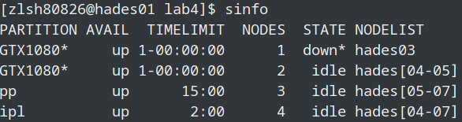
Job Scheduler
SLURM
Course partition: pp
Limitation
2 gpus
10 minutes

Slide 7
Access Resource
hades02
ssh to hades02
export CUDA_VISIBLE_DEVICES=<gpu id>
eg. export CUDA_VISIBLE_DEVICES=0
eg. export CUDA_VISIBLE_DEVICES=0,1
hades[05-07]
Slurm
Access gpus with flag --gres=gpu:<number of gpu>
eg. srun -n 1 -p pp --gres=gpu:1 ./executable
eg. srun -n 1 -p pp --gres=gpu:2 ./executable

Slide 8
Compile & run
Compiler nvcc
nvcc [options] <inputfile>
eg. nvcc cuda_code.cu -o cuda_executable
Run
Refer to the previous slide

Slide 9
Practice 1 (In class only)
In this practice, you are asked to run the deviceQuery on
hades02
scheduler
Compile
cp /home/pp19/share/deviceQuery ~/ -r
cd deviceQuery
nvcc deviceQuery.cpp -o deviceQuery
Run it on
hades02
scheduler
Demo how many CUDA cores on GTX1080

Slide 10
Tools

Slide 11
nvidia-smi
NVIDIA System Management Interface program
You can query details about
gpu type
gpu utilization
memory usage
temperature
clock rate
...

Slide 12
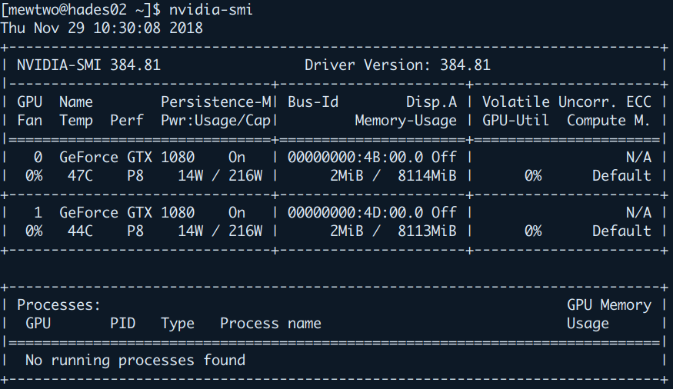
nvidia-smi example

Slide 13
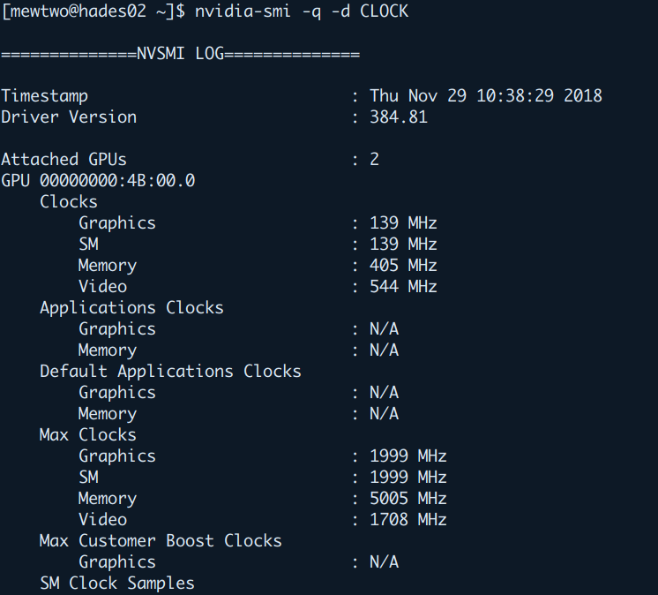
nvidia-smi example

Slide 14
cuda-memcheck
This tool checks memory errors of your program, and it also reports hardware exceptions encountered by the GPU. These errors may not cause program to crash, but they could result in unexpected program behavior and memory misusage.
Error types
cuda-tutorial

Slide 15
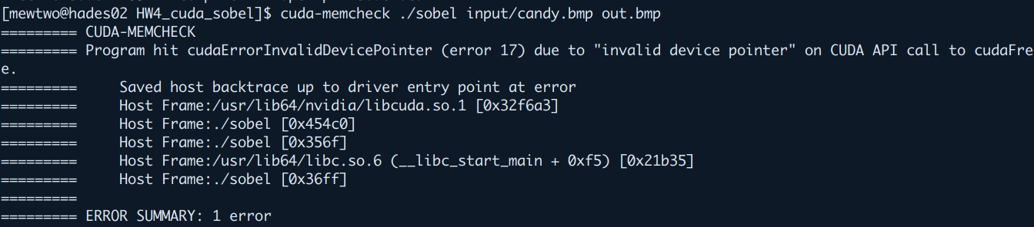
cuda-memcheck

Slide 16
cuda-gdb
cuda-gdb tutorial

Slide 17
nvprof
A CUDA profiler provides feedback to optimize CUDA programs
--metrics <METRIC_NAME> to measure specific metrics
--events <EVENT_NAME> to record specific events
-o <FILE> to save result to a file
-i <FILE> to read result from a file

Slide 18
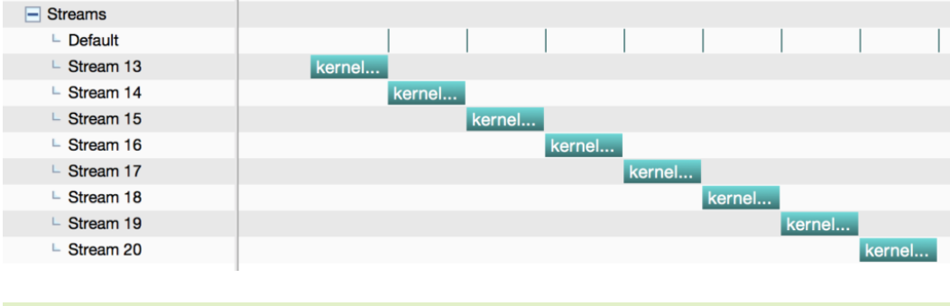
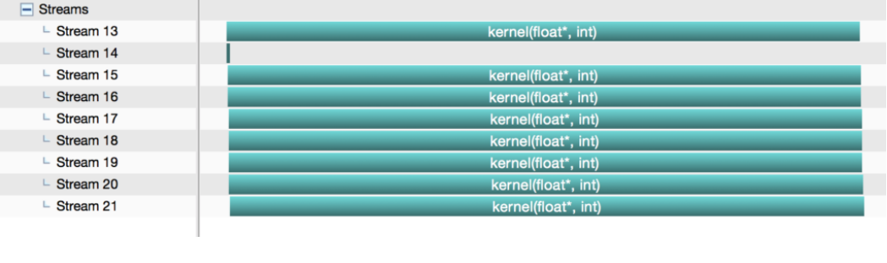
nvvp
nvvp-tutorial
GUI version of nvprof
Useful for the stream optimization
Timeline
nvvp is useful for checking the concurrency of stream

Slide 19
Lab4 Assignment

Slide 20

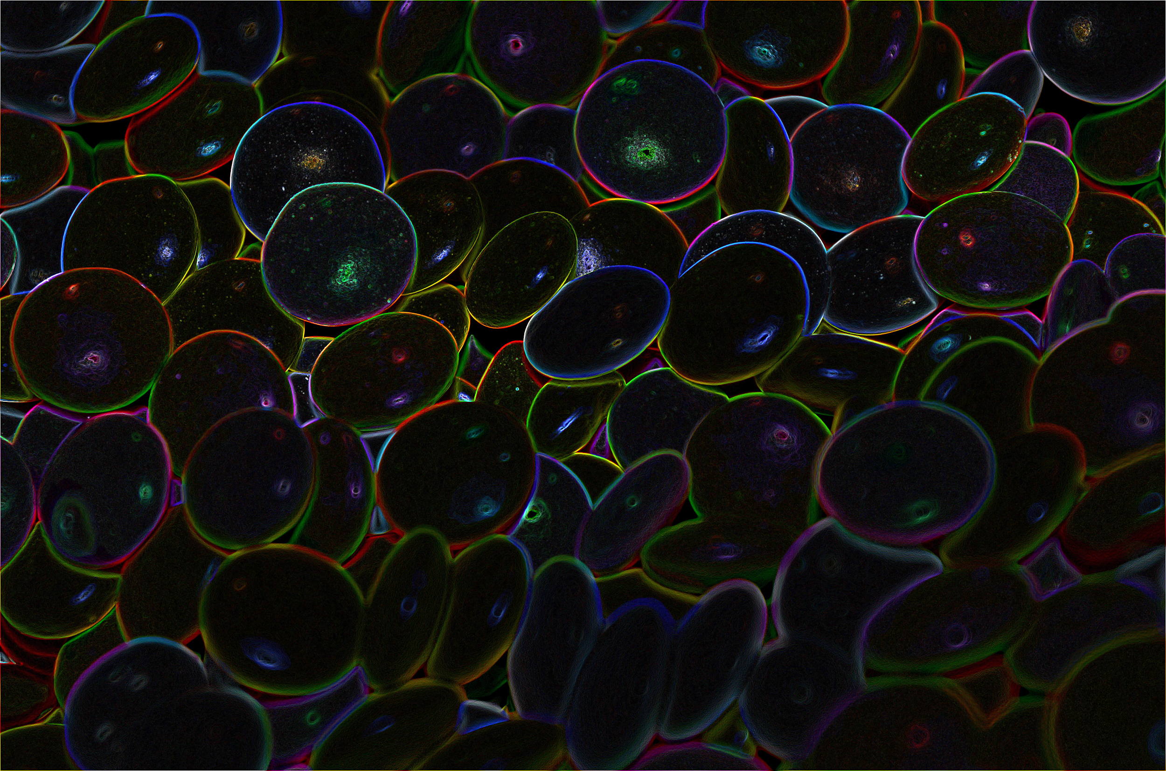
Problem Description
Edge Detection: Identifying points in a digital image at which the image brightness changes sharply

Slide 21
Sobel Operator
Used in image processing and computer vision, particularly within edge detection algorithms.
Uses two 3x3 kernels gx, gy which are convolved with the original image to calculate approximations of the derivatives - one for horizontal changes, and one for vertical.
At each point in the image, the result of the Sobel operator is either the corresponding gradient vector or the norm of this vector.

Slide 22
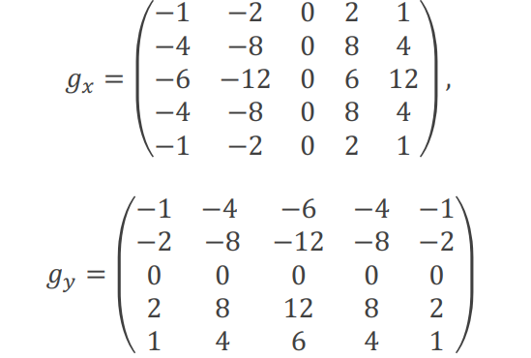
5x5 Variation
We use this kernel instead of the 3x3 one in this lab

Slide 23
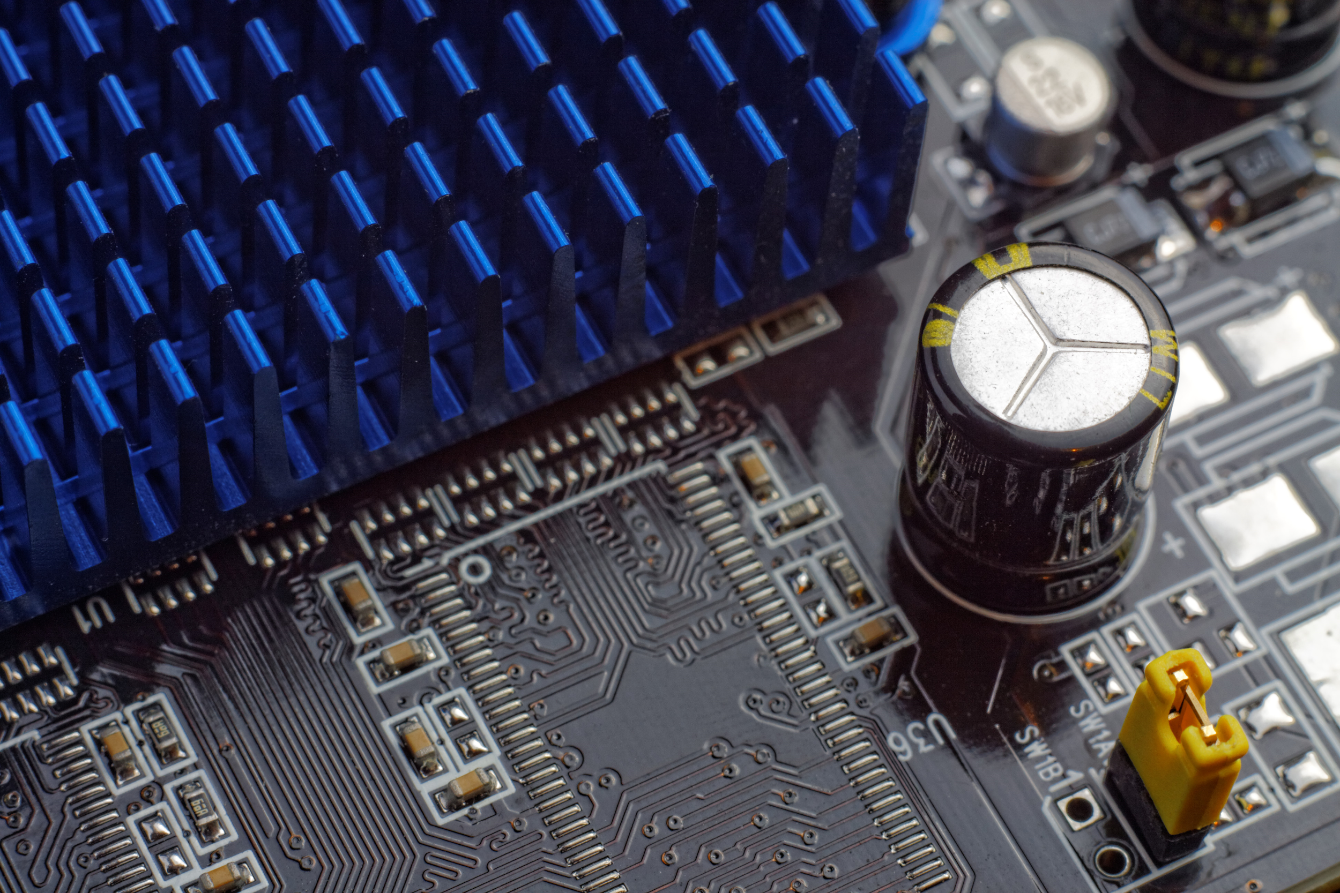
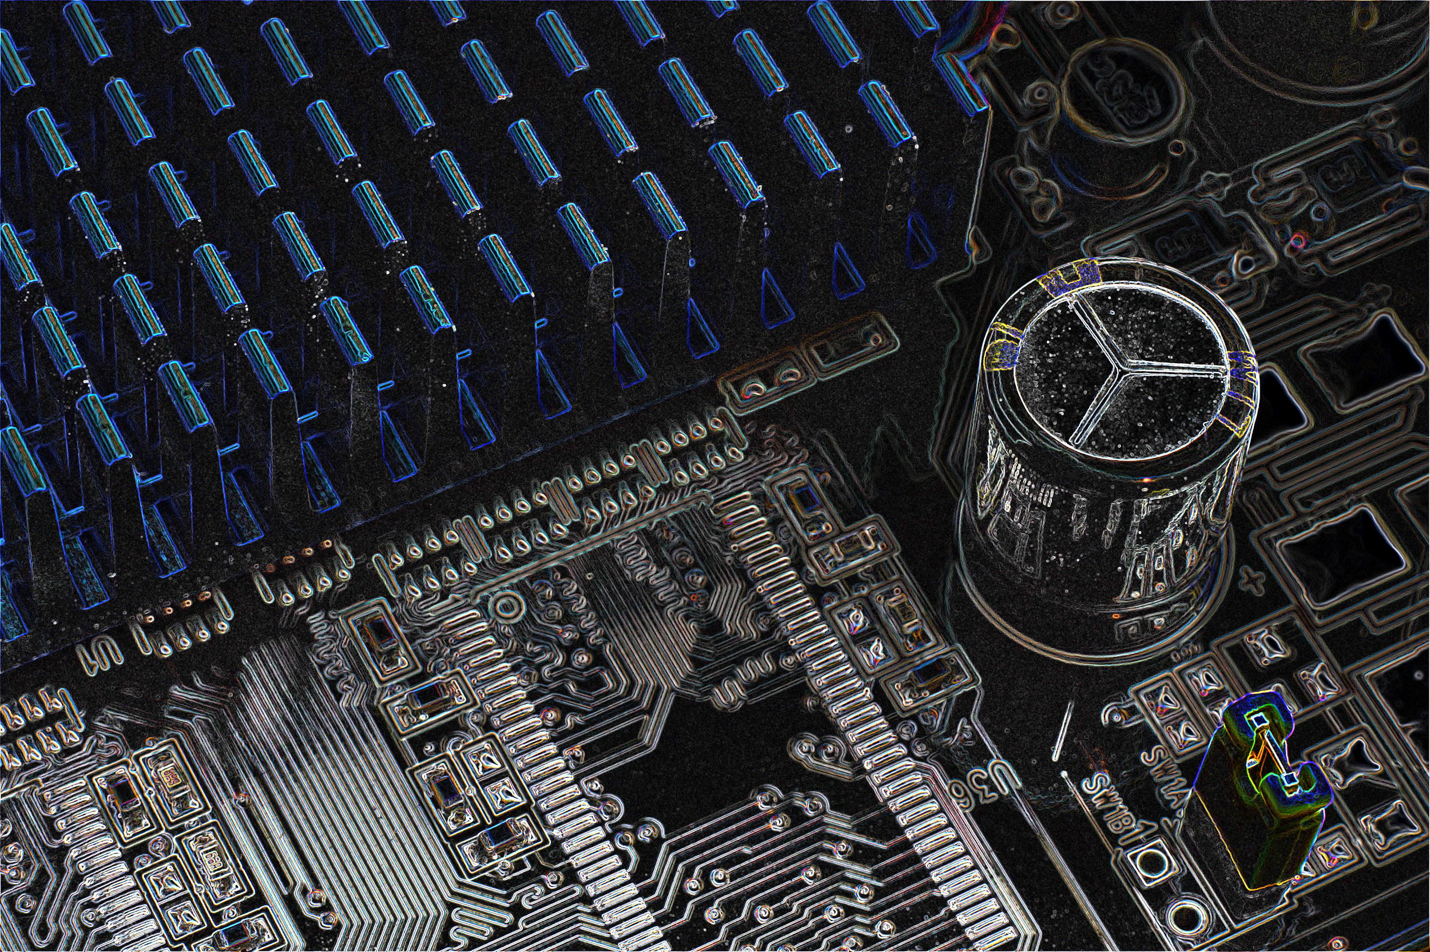
Sample Result

Slide 24
Preparation
TA provides CPU version, Makefile
mkdir ~/homework
cp /home/pp19/share/lab4 ~/homework -r
sobel.c is cpu version
sobel.cu is same as sobel.cc (you need to rewrite it with cuda!)

Slide 25
How to run
hades02
./sobel <input> <output>
CUDA_VISIBLE_DEVICES=0 ./sobel.cuda <input> <output>
hades[05-07]
srun -n 1 ./sobel <input> <output>
srun -n 1 -p pp --gres=gpu:1 ./sobel.cuda <input> <output>
Compare your result with the answer
lab4-diff <output image> <answer image>

Slide 26
Hints
Malloc memory on GPU
Copy original image to GPU
Put filter matrix on device memory (or declare it on device)
Copy filter matrix to shared memory (don’t let only one thread do it)
Parallel the sobel computing
Copy the results from device to host
Free unused address

Slide 27
Submission
Finish it before you leave
Demo
cuda-memcheck without any error
output correct answer
explain your code
measure your computation time
If you can’t finish it on class
handout your [code, Makefile, report] to ilms before 11/10 23:59

